Slide 1
Post-Stroke and Aphasia Friendly Workout/Stretches
John Reuter

Slide 2
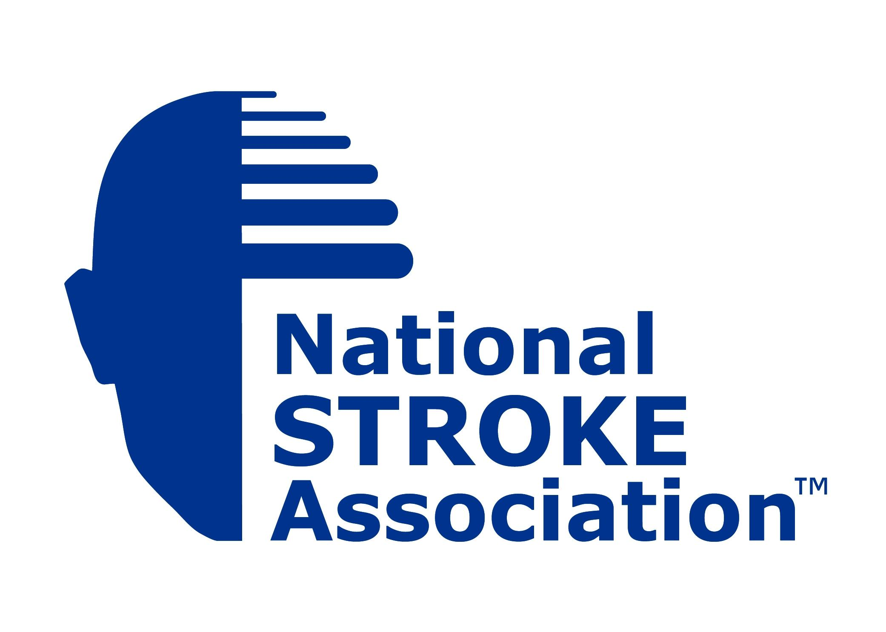
Benefits of these exercises/stretches
Require less assistance for stair climbing
Move more steadily when you walk
Improve balance and endurance
Strengthen and refine movement patterns
Improve the coordination and speed of movement necessary for fine motor skills, such as fastening buttons or tying shoelaces

Slide 3
Exercise in general
Relatively new application to this population of individuals
Recent evidence has shown us that muscle strengthening exercises (i.e., using weights, elastic bands, etc.) can improve muscle strength post-stroke without increasing spasticity
Evidence suggests that a combination of muscle strengthening and task-specific exercises may be necessary to enhance transfer to functional tasks.

Slide 4
Exercise prevention of complications
In addition to motor function value, and benefits, there is a growing recognition of the value of EXERCISE applications that address secondary complications post-stroke.
Less falling
Less dependence on others
Getting up and down stairs
etc.

Slide 5
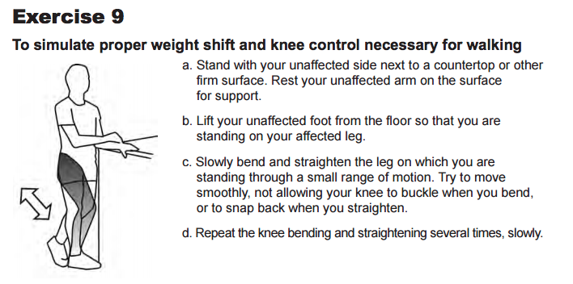

Slide 7
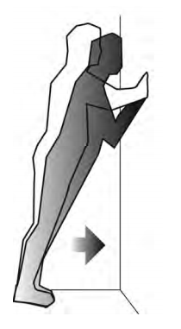
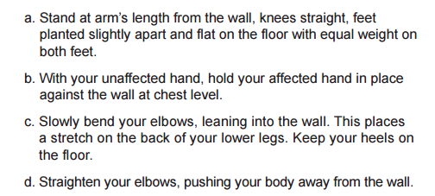

Slide 8
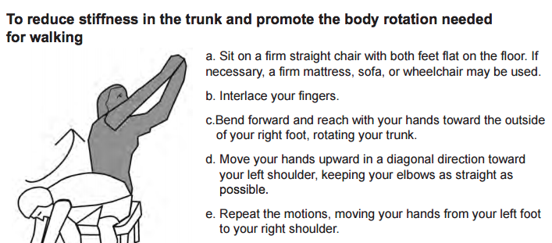

Slide 9
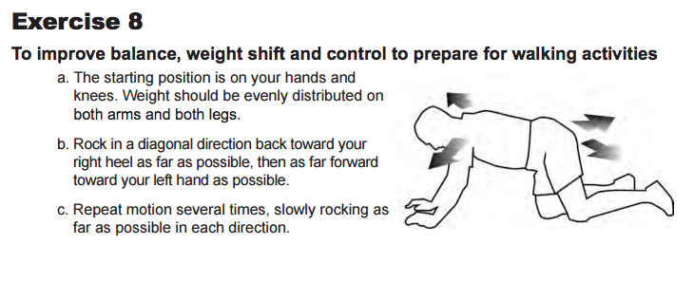

Slide 10
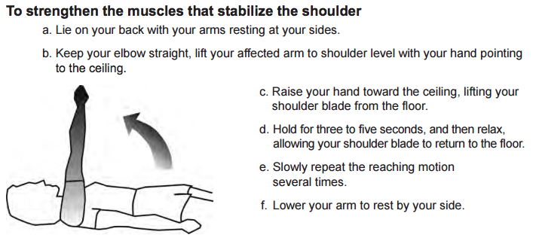

Slide 11
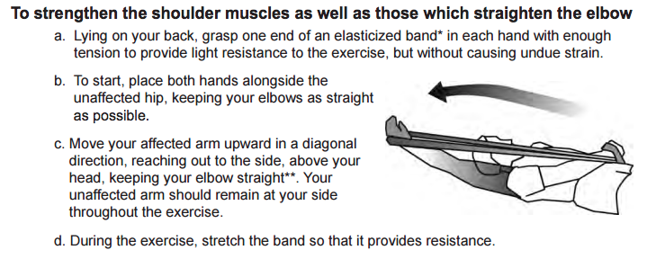

Slide 12
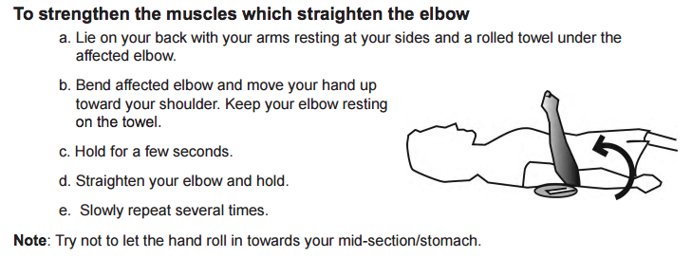

Slide 13
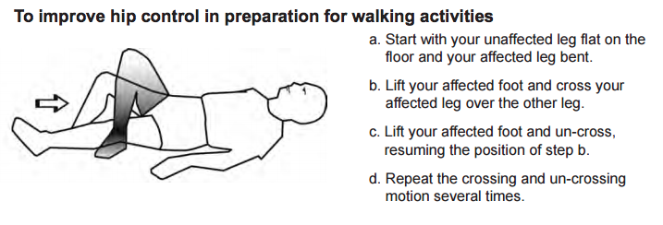

Slide 14
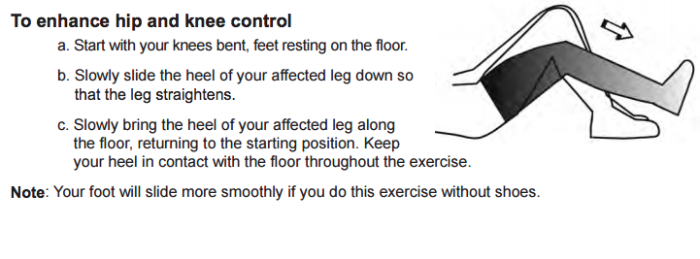

Slide 15
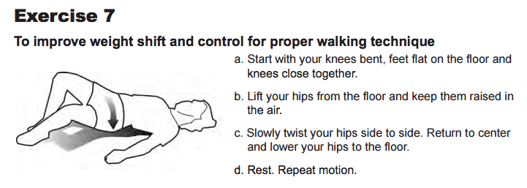

Slide 16
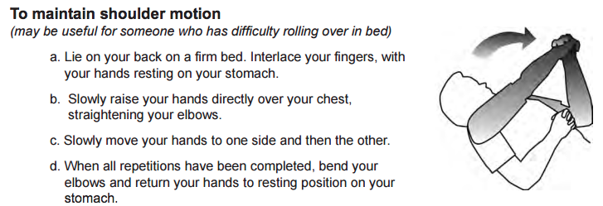

Slide 17
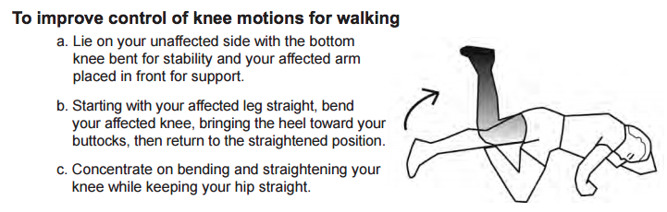

Slide 18
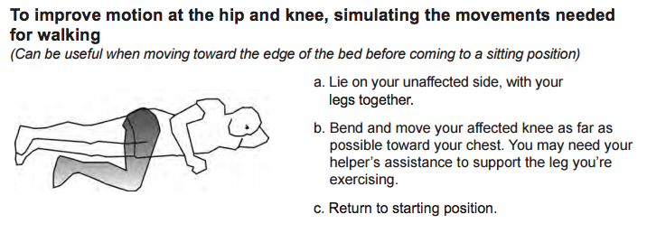

Slide 19
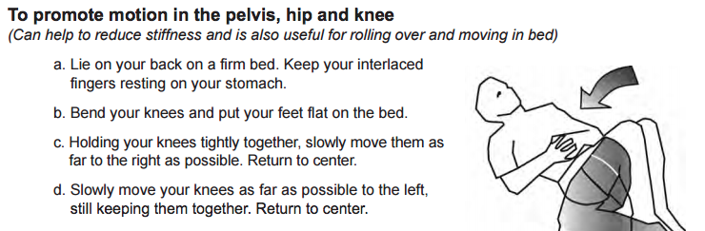

Slide 20
Please take home all of these stretches and exercises and try them on your own or with a family member so you can achieve more when it comes to general daily activities!

Slide 21
Thanks to all of you wonderful folks for joining me today! Hope you take some of this home with you, and your daily activities get easier and easier! It was a pleasure working with everyone today.

Slide 22
http://www.ncbi.nlm.nih.gov/pmc/articles/PMC3266302/pdf/nihms1990.pdf
https://www.stroke.org/sites/default/files/resources/NSA-Hope-Guide.pdf

